Slide 1
DESIGNING FOR INFORMED CONSENT
A PROTOTYPE FOR THE ACCOUNT AGGREGATOR FRAMEWORK
CONSENT FORM
Risks and benefits
Choice
Redressal
Risk Assessment
Data Journey
I want other options
Quantitative insights from a behavioural study
I reject
I accept
July - December 2022

Slide 2
Acknowledgements
Acknowledgments
This study is conceptualised by Dvara Research and executed by Final Mile. It is funded by the Bill and Melinda Gates Foundation. We thank stakeholders from Dvara Research, Design Beku, OneMoney, SETU, and Mool for their support in helping us understand their context. We also extend gratitude to Paul Adams (IPA) and David Medine (CGAP) for their intellectual challenge and stimulation.
We also appreciate our partner Dunnock Research, who supported our research field operations, and the respondents for their participation in the study.
While we have benefitted from the support of these colleagues and partners, any deficiencies in this report are our own.
About Dvara Research
About Final Mile
Dvara Research is a policy research institution based in India. Their mission is to ensure that every individual and every enterprise has complete access to financial services. They strongly believe in the deeply transformative power of finance in unlocking the potential of individuals, households, enterprises and local governments.
Final Mile is the world’s first organisation to bring into practice Cognitive Neuroscience and Behavioural Economics to the disciplines of Social Behaviour, Marketing and Organisational Behaviour. Final Mile is committed to bring in industry-leading expertise in application of behavioural sciences to solve complex public health challenges. They have substantial experience in the development sector globally.

Slide 3
Project context
The Reserve Bank of India (RBI)’s Guidelines on Digital Lending (2022) and their Master Directions on NBFC-Account Aggregators (AAs) (2016) require that consent obtained by these financial service providers (FSPs) be explicit, prior, and revokable.
However, the consent customers give is far from meeting the RBI’s standards. These consent screens overlook customers’ digital and traditional literacy, cognitive biases, mental models and other behavioural factors. This forces customers to disengage from the consent process and comply passively with it.
This project, building on findings from a behavioural study, aims to redesign consent screens so that customers can –
read and understand the terms and conditions about how FSPs will use their personal data, and,
provide informed, thoughtful consent that upholds their right to privacy and data protection.
Our redesigned screens would specifically aim to be relevant for new-to-finance, digital immigrant customers with low income and literacy (‘constrained customers’).
In this project, we apply the findings from the behavioural study to the use case of constrained users applying for a loan through Account Aggregators.

Slide 4
Project timelines
June to July 2022
September to October 2022
Ongoing
STAGE 1: STAKEHOLDER IMMERSION, LITERATURE REVIEW
STAGE 2: FIELD STUDY
STAGE 3: TEST THE REDESIGNED CONSENT SCREEN WITH FSPs
Outputs
Designing effective consent screens under the Account Aggregator framework.
The behavioural mechanics that make notice-and-consent models ineffective.
Upcoming: Blogpost with findings on behavioural factors impeding customers’ active engagement with consent artefacts, and behaviourally-informed design levers to make artefacts more effective.
Outputs
Quantitative findings presented in this report.
Upcoming:
Final report with a design toolkit for providers.
Interactive toolkit with design strategies for designing effective consent.

Slide 5
1. Problem statement, project objective & hypotheses

Slide 6
Problem statement
“How might we redesign the consent screen so that constrained customers may actively engage with it?”
Customers’ behavioural dispositions
Lack of choice due to the design of consent
Power asymmetry between the customer & FSP
Limited literacy
How might we catapult the constrained customer to active engagement?
Drop off due to passive engagement
The consent screens that exist today fall short of accounting for behavioural hurdles that customers face in actively reading and comprehending them. Resultantly, customers default to complying with the consent screen without actively processing it. This is far from the RBI’s established standard of informed consent. This project seeks to give constrained customers a fighting chance at providing informed consent by using behavioural science to inform the design of consent screens and address underlying behavioural barriers.

Slide 7
Project objective
“From default consent to deliberate consent”
Problem context
It is well established that customers are unable to read consent artefacts and often consent-by-default. Commonly cited factors for this are:
Lack of choice: Consent artefacts are framed as take-it-or-leave-it notices that do not give customers any effective choice about giving consent.
Power Asymmetry: The lack of choice diminishes customers’ agency, making them feel powerless, discouraging them from engaging with the artefacts.
Limited literacy: Customers’ limited literacy, financial and digital literacy, makes artefacts difficult to comprehend and understand.
But there are deeper behavioural factors influencing the customers’ decision to invest time and bandwidth in the consent screens that unfortunately go unaccounted for. Uncovering these factors can help providers design better screens to obtain active and valid consent.
Project Objective
To apply behavioural science principles to design effective consent screens that are comprehensible to constrained customers of AAs. Specifically, to:
Identify the behavioral enablers and barriers that constrained customers specifically face when engaging with consent.
Provide design principles to satisfy the six elements for valid consent set out by the RBI:¹
accessible, i.e., consent should be designed for all interfaces
comprehensible, i.e., consent should be easy to understand
free, i.e., consent should not be coercive
informed, i.e., consent should provide necessary information
specific, i.e., consent should clearly indicate the purposes
revocable, i.e., consent should be withdrawable
Test the prototypes in the field with customers in collaboration with AAs and financial service providers.
¹ See the RBI’s Guidelines on Digital Lending (2022) and their Master Directions on NBFC-Account Aggregators (2016)

Slide 8
Building the hypotheses
The review of the literature and stakeholder immersion yielded three potential causes for low customer-engagement with consent artefacts (descriptive hypotheses) and two potential solutions (prescriptive hypotheses).
(Descriptive) Hypotheses around passive customer engagement with consent
(Prescriptive) Hypotheses around possible solutions to increase customers’ engagement with consent
Low intrinsic value i.e., customers attach little value to consent in the loan transaction.
Improving customers’ engagement by making consent screens more interactive.
Lack of relevance i.e., customers do not find consent relevant in the loan transaction.
Building relevance for consent by –
Creating a space that can change customers’ attitudes about consent and make them deliberately engage with it.
Slowing down customers’ interaction with the consent screen so that they engage with it more.
Limited perceived control i.e., customers don’t find engaging with consent artefacts useful because they think they have little to no control over the decision to give consent.
These thematic hypotheses were unpacked to yield specific hypotheses to be tested through the behavioural, primary study.

Slide 9
Unpacking descriptive hypotheses
Why might customers not engage with consent artefacts?
Low intrinsic value
Customers attach little value to consent in the loan transaction.
Lack of relevance
Customers don’t find consent relevant to the loan transaction.
Limited perceived control
Customers don’t engage with consent artefacts because they think they don’t have control over the decision to give consent.
Unpleasantness or negative valence: Customers find financial processes unpleasant and refrain from active participation.
Hyperbolic discounting or present bias: Customers privilege getting the loan over protecting their personal data.
Anticipated regret: Customers weigh the negative consequences of not consenting for the loan over the benefits of giving informed consent.
Unfamiliarity and novelty: Customers don’t know about AAs or other similar processes.
Outcome probability: Customers are more concerned about the outcome of the loan process.
No use-case: Customers don’t understand data protection in the larger context of the loan transaction they are involved.
Power asymmetry: Customers feel powerless, believing the outcome of the loan process is not in their control.
Failure avoidance: Customers want to avoid doing anything that can affect the loan outcome negatively.
Anticipated costs: Customers anticipate being exposed to risks and costs in the future by being involved in the AA process.
The hypothesis are linked to the EnthnoLabTM scenarios built later in the process

Slide 10
Unpacking prescriptive hypotheses
What could possibly make constrained customers actively engage with consent artefacts?
Improving customers’ engagement
How might we make consent more interactive?
Limited perceived control
Customers don’t engage with consent artefacts because they think they don’t have control over the decision to give consent.
Consent through dialogue: Pre-recorded or real-time assisted consent.
Shared understanding: Customers explain back what they understood about consent.
Leverage familiarity: Customers are provided with an environment they are familiar with.
Improve pre-consent attention: Provide customers with a view of an end-to-end consent journey.
Reduce sense of urgency by allowing customers to defer decisions briefly.
Improve locus of control by allowing customers to locate themselves in the consent journey.
Making benefits relevant: Customers are made aware of the benefits of using an AA.
Leverage need: Customers are made aware of the need to provide informed consent.
Leverage outcome orientation: Redefine or reframe the outcomes of the consent process to direct customers towards desired behaviour.
Build ability to cope: Customers have additional cues on and off the screen to take help from during the consent action.
Support comprehensibility: Customers receive smaller, modular consent notices.
Improve self-attribution: Customers receive cues aimed at improving their sense of ownership over the consent process and decision.
The hypothesis are linked to the EnthnoLabTM scenarios built later in the process

Slide 11
2. Sampling & methodology

Slide 12
Methodology: Gamified behavioural study using EthnoLabTM
EthnoLabTM is a proprietary research methodology developed by The Final Mile to understand human behaviors and decision-making.
It is a platform designed to overcome limitations of conventional research by eliciting participants’ decision drivers and behaviors through deliberation.
The platform simulates multiple decision-making contexts to engage participants in game-like environments where they make decisions related to the topic of study. Post the game, the participants are engaged in curated conversations aimed at relating decisions made in the game context with real life situations.
100+ EthnoLabsTM have been executed across sectors and target populations.
Non-conscious nature of decision making
Awareness – Intent – Action Gap
Impact of the Research Context
The role of the non-conscious brain in decision-making is a well-established fact. Therefore, self-reporting is not a reliable method for probing non-conscious tendencies, as participants may not be fully aware of ‘why’ they act the way they do.
A gamified survey reveals participants’ underlying preferences and their drivers
Participants’ incentives are not always aligned towards accurate and honest responses.
They may be motivated to provide ‘socially desirable’ or ‘correct’ responses. Additionally, some topics might be sensitive in nature, therefore impeding honest conversations.
These challenges are particularly salient in the unique context of research about health and well-being of vulnerable groups
Self-reports captured by surveys and conventional research often only capture the intent but fail to understand barriers that prevent the intent from getting translated into action.
An innovative approach is required to explain the ‘intent- action gap’, devise strategies for bridging the gap by eliciting levers to drive action.
Design Workshop

Slide 13
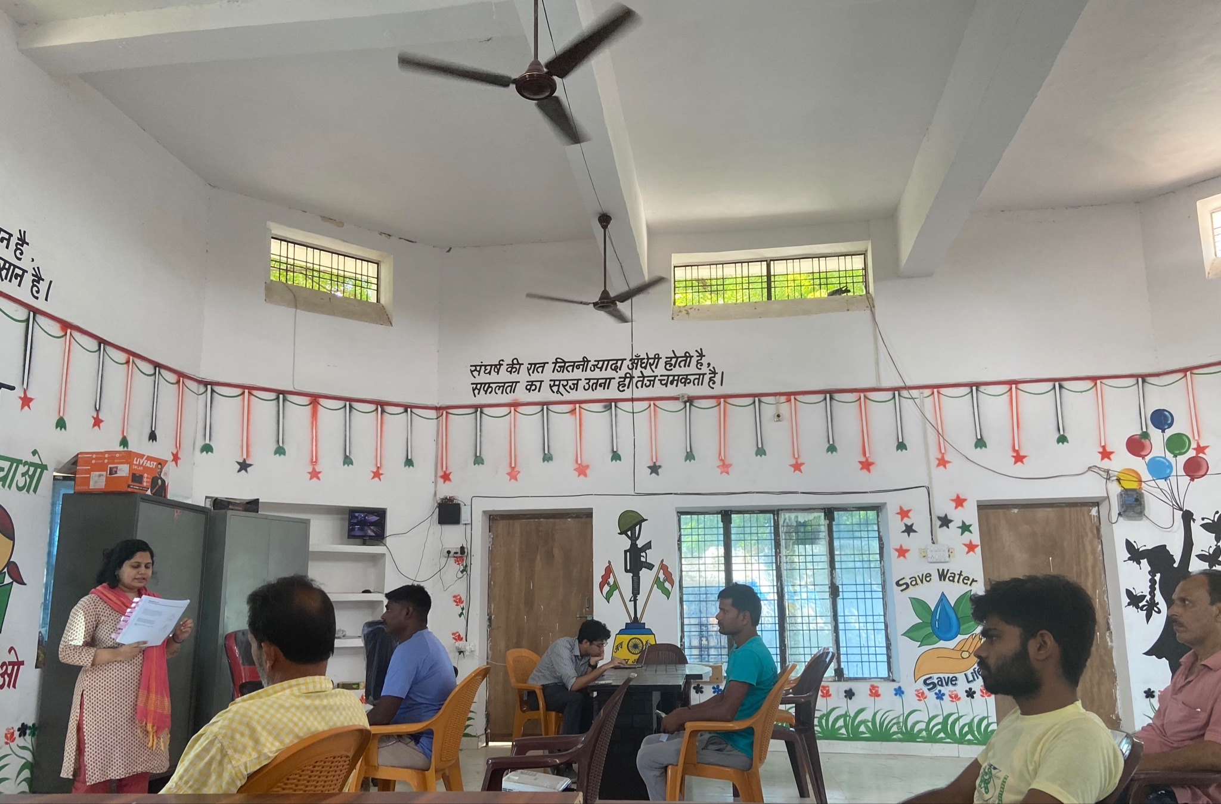
Methodology Overview: The Conundrum Game
Grouping: Respondents were divided into groups of five. Respondents in each group shared similar demographic features, including similar phone ownership.
The Questions: Respondents were immersed in seven life-like scenario with relatable characters. The scenarios simulated characters engaging with consent screen while seeking a loan for different purposes.
The responses: Each respondent’s pick was concealed from other respondents and recorded on a paper strip containing three options.
Recreating behavioural biases: Each respondent had to make a hot-state decision from three options presented to them. Each option was crafted to suit one of the hypotheses being tested in the project.
A primary study in motion in Kasmanda, Uttar Pradesh.
The game: The respondent is encouraged to pick the option that they immediately think is most appropriate. The respondent scores a point if the option they pick is the same as the option the majority of the respondents in the room picked. Highest scorer wins.
Post-game debrief: The respondents in each group are split into groups for a post-game discussion to probe deeper into their answers, and to better understand their own experiences in similar scenarios to isolate behavioural mechanisms that drove their decisions.

Slide 14
The sample
Total Sample: 60
Gender |  | Phone ownership |  | Annual Household Income (INR)
Male | 32 | Feature phone | 30 | 2,00,000 – 3,00,000 | 19
Female | 28 | Smartphone | 30 | 3,00,001 – 5,00,000 | 41
Location |  | Location |  | Occupation
Kasmanda, Uttar Pradesh (Rural) |  | Kasmanda, Uttar Pradesh (Rural) | 20 | Farm | 8
Sitapur, Uttar Pradesh (Semi-urban) |  | Sitapur, Uttar Pradesh (Semi-urban) | 20 | Non-farm | 35
Mumbai, Maharashtra (Urban) |  |  | 20 | Unemployed | 17
Age (years) |  | Language proficiency |  | Education
18-35 | 28 | Hindi | 50 | School-level | 32
36-50 | 21 | Marathi | 10 | College-level | 28
Above 51 | 11
Experience with credit |  | Digital financial services usage |  | Experience with digital financial fraud
Formal credit | 19 | Frequent | 24 | Yes | 53
Informal credit | 7 | Infrequent | 24 | No | 7
No history | 34 | No usage | 12

Slide 15
3. EthnoLab™ scenarios & findings

Slide 16
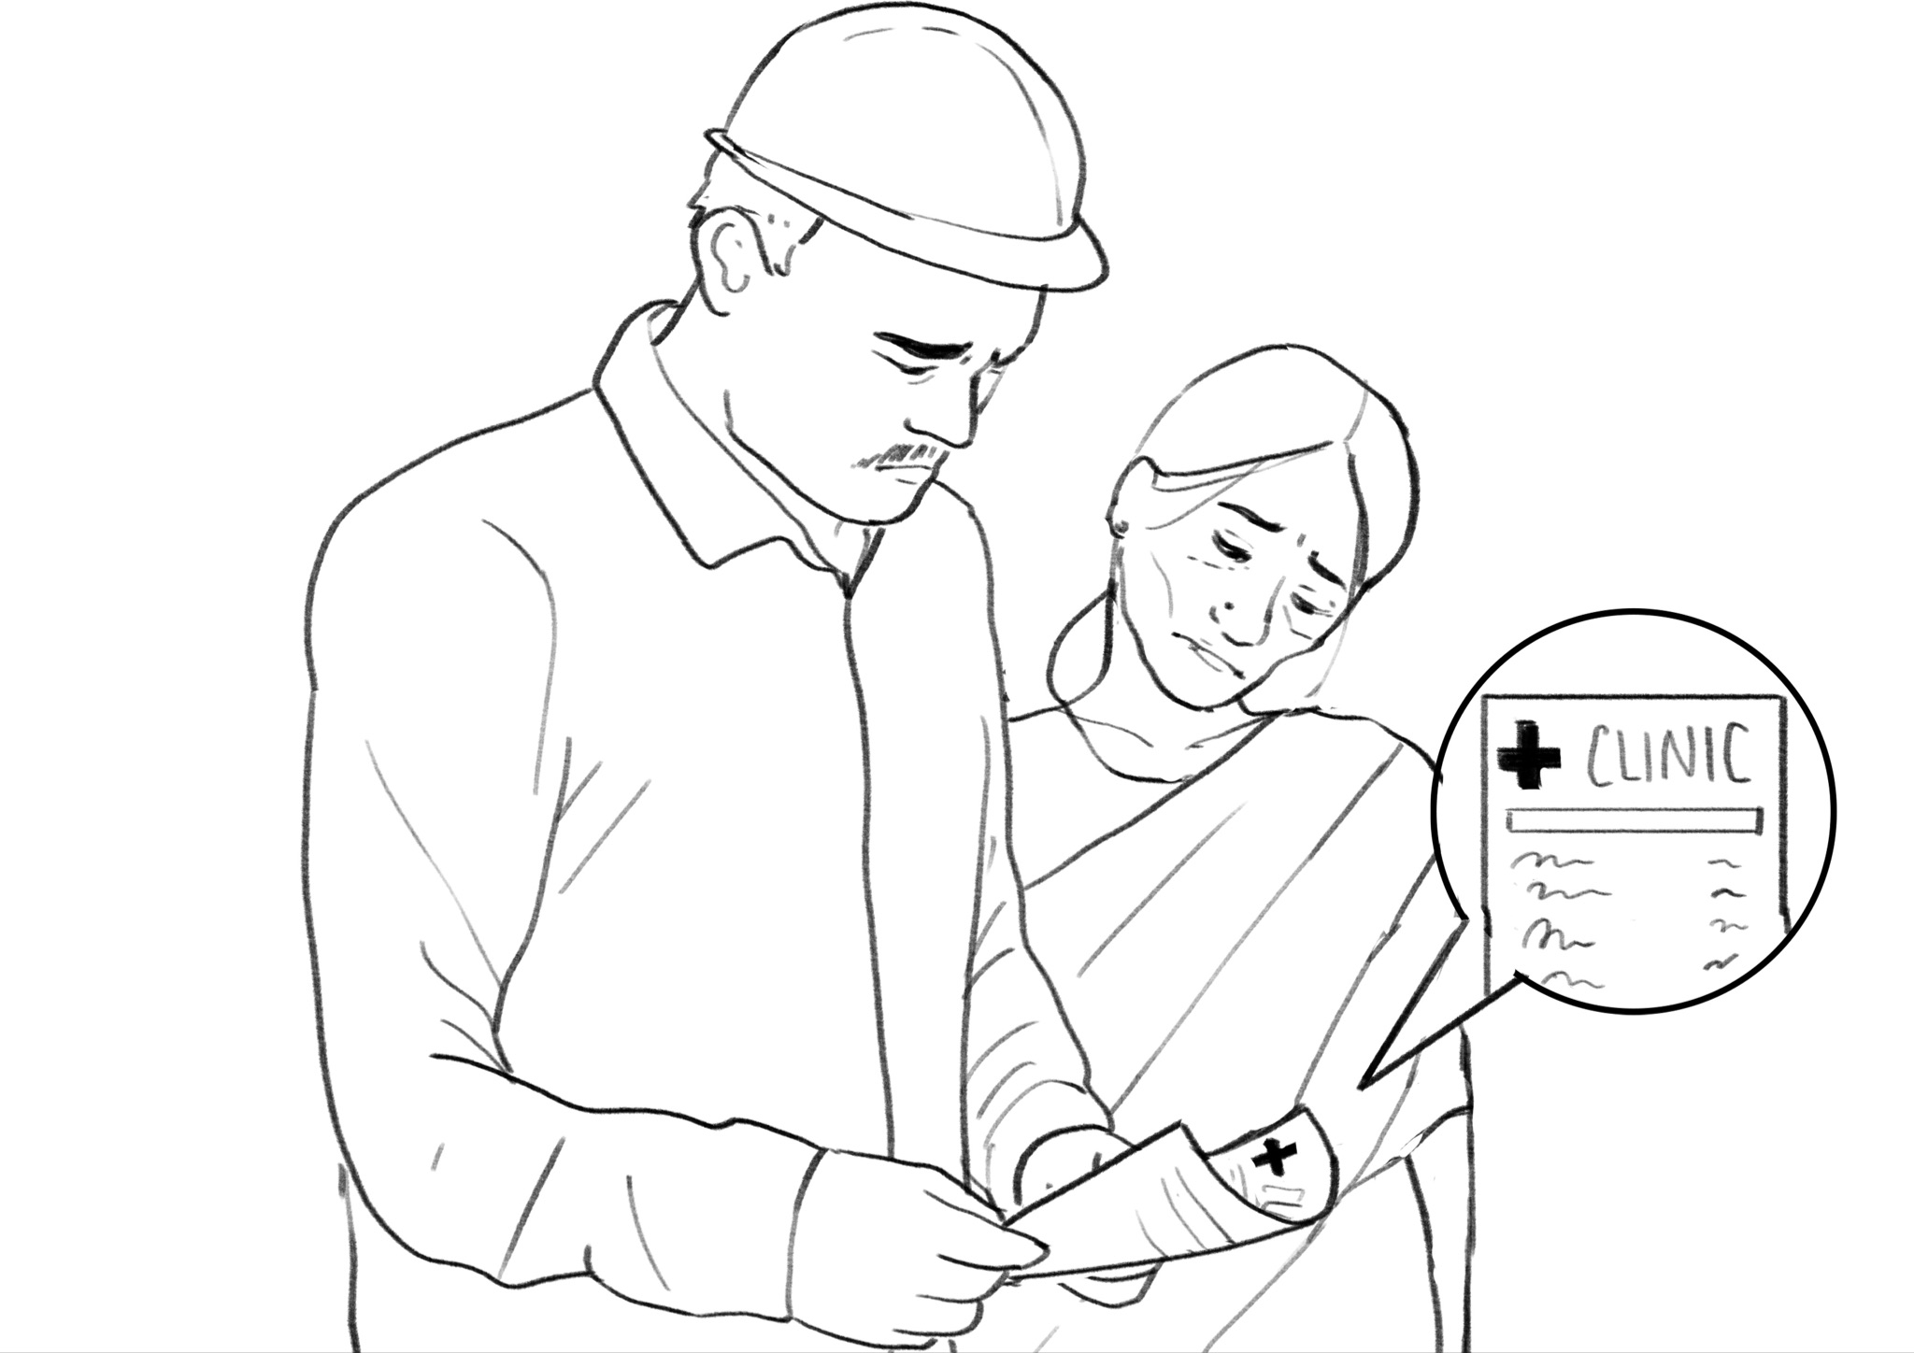
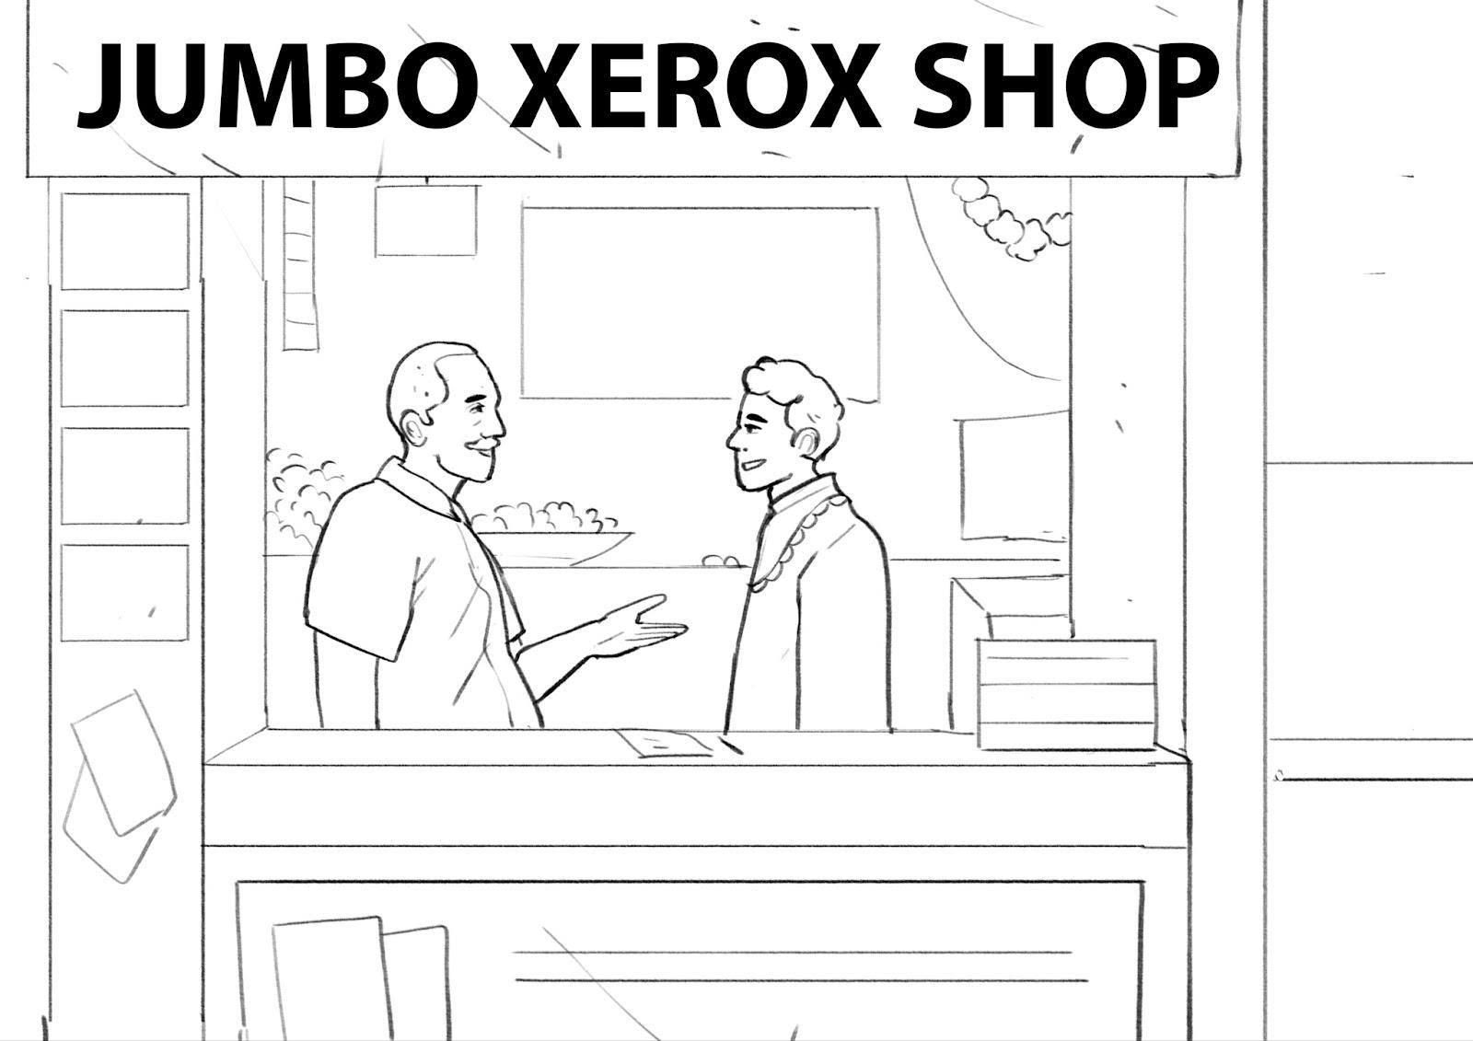
EthnoLabTM scenarios: Testing the descriptive hypotheses
-Scenario 1-
Bablu needs a loan for medical expenditures
Low intrinsic value i.e.,
customers attach little value to consent in the loan transaction
-Scenario 2-
Raja wants to buy a two-wheeler
Lack of relevance i.e.,
customers don’t find consent to be relevant in the loan transaction
-Scenario 3-
Sameer wants a loan
Limited perceived control i.e., customers don’t find engaging with consent artefacts useful because they think they have little to no control over the decision to give consent
Notes:
Title
Mindfulness in financial literacy
Emotion and cognition in financial decision making
What Can Behavioral Economics Teach Us About Privacy
Privacy Paradox
Imagined Communities: Awareness, Information Sharing, and Privacy on the Facebook
Privacy Attitudes and Privacy Behavior
Customers Want Data Protection: How Can Open API Providers Deliver?
The UX of Consent Models in Open Banking
Against Notice Skepticism
The Relationship Between Uncertainty and Affect
Disclosure: Psychology Changes Everything
Judgment Under Emotional Certainty and Uncertainty: The Effects of Specific Emotions on Information Processing
Information Gaps for Risk and Ambiguity
Appraisal Theory and Social Appraisals
Physical Theory of Information Processing in the Mind: Concepts and Emotions
Privacy and Rationality in Individual Decision Making
Won’t You Think of Others? Interdependent Privacy in Smartphone App Permissions
Disentangling Risk and Uncertainty: When Risk-Taking Measures Are Not About Risk
The Behavioral Role of Digital Economy Adaptation in Sustainable Financial Literacy and Financial Inclusion
Currency of Trust
Uncertainty Makes Me Emotional: Uncertainty as an Elicitor and Modulator of Emotional States
Examining the language demands of informed consent documents in patient recruitment to cancer trials using tools from corpus and computational linguistics
Written Informed Consent—Translating into Plain Language. A Pilot Study
Interventions to improve patient comprehension in informed consent for medical and surgical procedures: a systematic review
The Appropriateness of Language Found in Research Consent Form Templates: A Computational Linguistic Analysis
Recommended Informed Consent Language for Data Sharing
CONSENT TO TAKE PART IN A RESEARCH STUDY
Privacy UX: Better Cookie Consent Experiences
Applying Social Cognitive Constructs of Motivation to
Enhance Student Success in
Online Distance Education

Slide 17
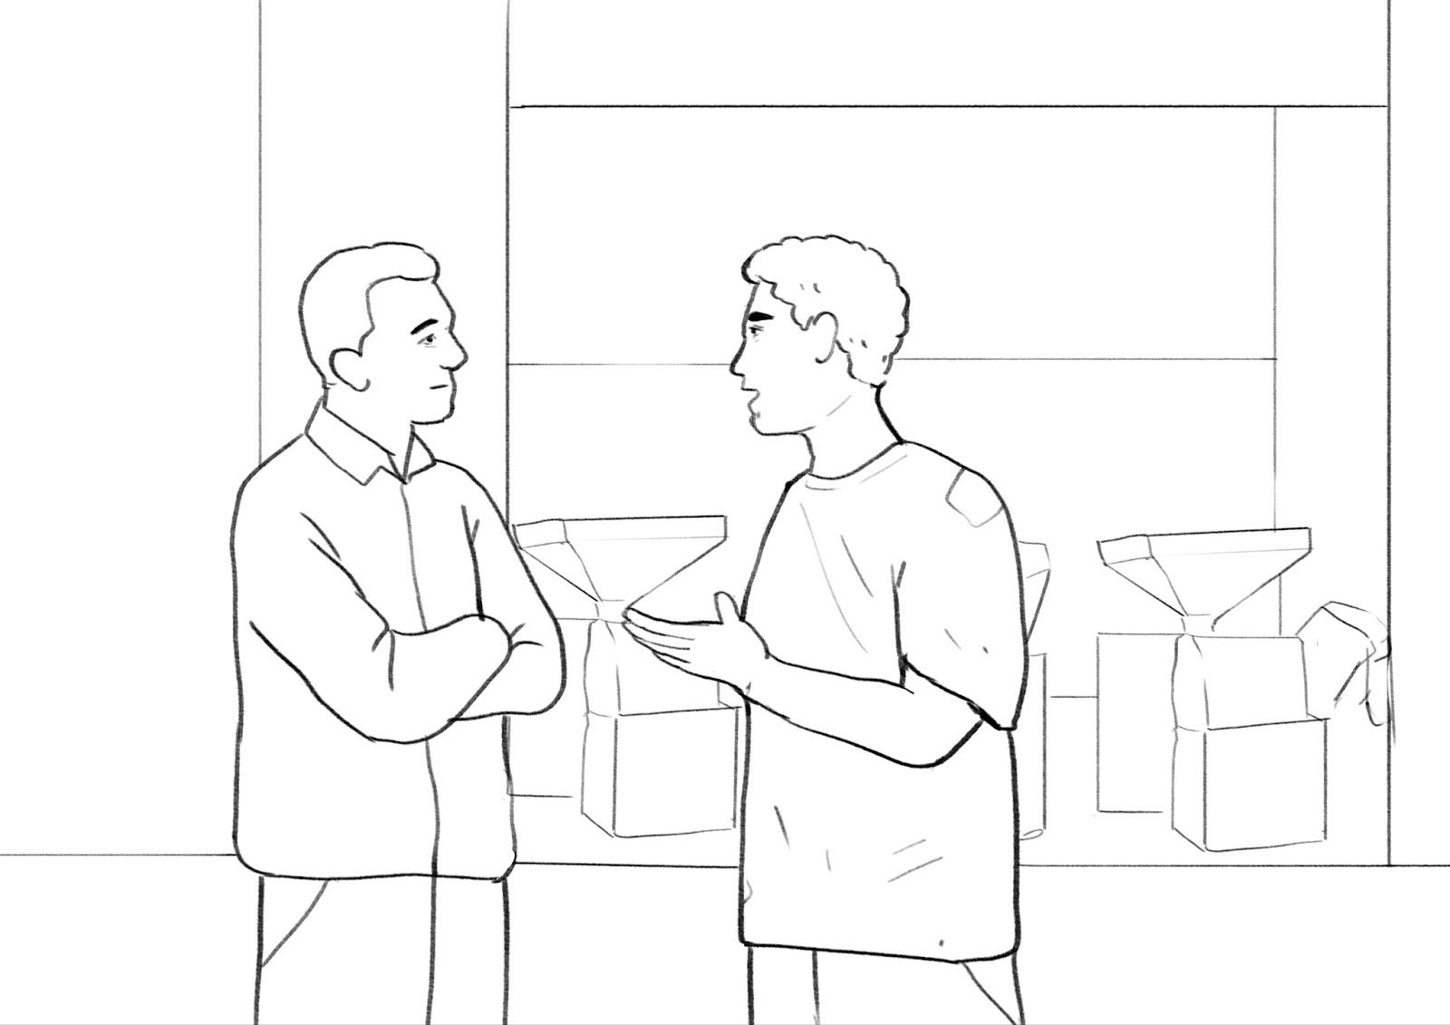
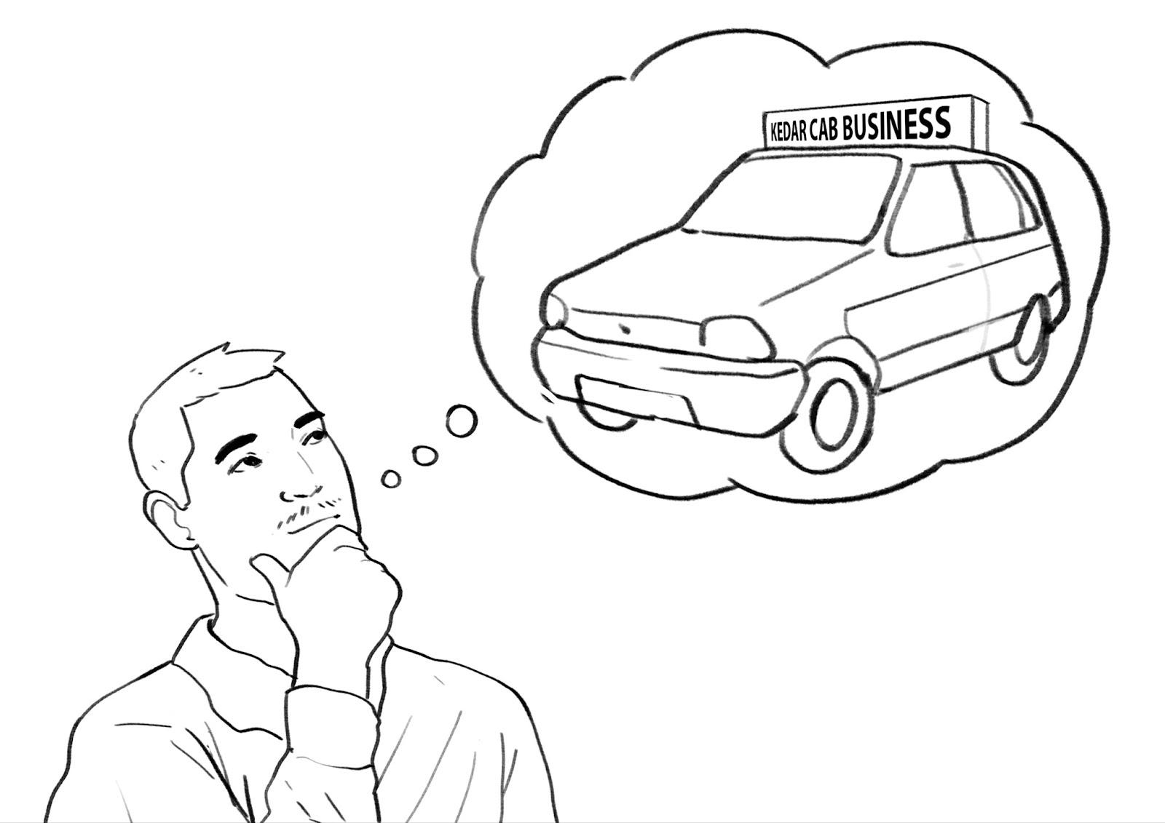
EthnoLabTM scenarios: Testing the prescriptive hypotheses
-Scenario 4-
Lila needs a loan for her sister’s marriage
Improving customers’ engagement by making consent artefacts more interactive
-Scenario 5-
Raja owns an atta chakki
Improving customers’ engagement by making consent artefacts more interactive
-Scenario 6-
Kedar wants to buy a car
Creating a space that can change customers’ attitudes about consent and make them deliberately engage with the artefact
-Scenario 7-
Matthew needs an education loan
Slowing down customers’ interaction with the consent artefact so that they engage with it more
Notes:
Title
Mindfulness in financial literacy
Emotion and cognition in financial decision making
What Can Behavioral Economics Teach Us About Privacy
Privacy Paradox
Imagined Communities: Awareness, Information Sharing, and Privacy on the Facebook
Privacy Attitudes and Privacy Behavior
Customers Want Data Protection: How Can Open API Providers Deliver?
The UX of Consent Models in Open Banking
Against Notice Skepticism
The Relationship Between Uncertainty and Affect
Disclosure: Psychology Changes Everything
Judgment Under Emotional Certainty and Uncertainty: The Effects of Specific Emotions on Information Processing
Information Gaps for Risk and Ambiguity
Appraisal Theory and Social Appraisals
Physical Theory of Information Processing in the Mind: Concepts and Emotions
Privacy and Rationality in Individual Decision Making
Won’t You Think of Others? Interdependent Privacy in Smartphone App Permissions
Disentangling Risk and Uncertainty: When Risk-Taking Measures Are Not About Risk
The Behavioral Role of Digital Economy Adaptation in Sustainable Financial Literacy and Financial Inclusion
Currency of Trust
Uncertainty Makes Me Emotional: Uncertainty as an Elicitor and Modulator of Emotional States
Examining the language demands of informed consent documents in patient recruitment to cancer trials using tools from corpus and computational linguistics
Written Informed Consent—Translating into Plain Language. A Pilot Study
Interventions to improve patient comprehension in informed consent for medical and surgical procedures: a systematic review
The Appropriateness of Language Found in Research Consent Form Templates: A Computational Linguistic Analysis
Recommended Informed Consent Language for Data Sharing
CONSENT TO TAKE PART IN A RESEARCH STUDY
Privacy UX: Better Cookie Consent Experiences
Applying Social Cognitive Constructs of Motivation to
Enhance Student Success in
Online Distance Education

Slide 18
Scenario 1: Extrinsic → Intrinsic value
INSIGHT
Within an urgent and stressful loan context, customers prefer adopting measures conducive to getting a loan swiftly and avoiding any negative consequences.
Bablu, a construction worker, wanted to take out a loan for the medical treatment for his family member.
He visits the nearest bank where he has had a savings account for the past 4 years. He meets the bank manager who explains the loan process to him and informs him that the bank needs to access his financial records to help process the loan.
The bank manager informs Bablu that he can share physical copies, but that process may take longer, hence he can opt for the digital/online way to share his documents with the bank.
He shall receive a message with details from the bank on his registered mobile number to share consent/permission to the bank to access his financial records such as current and savings bank accounts.
Later that day, the manager initiates the loan process and Bablu receives a message the manager had told him about.
He opens the message. What will he do now?
A
B
C
Bablu will read through the message quickly as he feels the loan process is stressful and he would want to get out of it as fast as he can.
Bablu will just skim through the message as getting a loan is more important than these process details on the form. He thinks that the quicker he gives consent the faster he will get loan approval.
Bablu will scroll through the message quickly as he does not understand this financial document and how the consent form truly impacts him.
 | A | B | C
 | 7% | 70% | 23%
 | 13% | 70% | 17%
Hypothesis: Customers find formal financial-related processes unpleasant, so they don’t want to be involved in them (Unpleasantness or negative valence)
Hypothesis: Customers feel that getting the loan is more important than ensuring that their data is protected (Hyperbolic discounting or present bias)
Hypothesis: Customers believe that not giving consent can have negative consequences for the loan, even if they cannot envision benefits of giving consent (Anticipated regret)

Slide 19
Scenario 2: Low → High relevance
INSIGHTS
Customers are outcome-oriented and focus on getting their loan approved. Their focus for becoming informed before giving consent is low as a result.
Raja recently started his tailoring job and wishes to buy a two-wheeler for his daily commute.
He applied for a loan in one of the local banks. After sharing his requirements with the bank representative, he received a message with details of a new online document sharing process.
The bank representative told him that there were two ways in which he could share data- one where he could submit the physical copies to the bank and the other way was to download an application.
In the application he could give consent/permission to the bank to directly get the data from other banks about his active bank and savings accounts. He didn’t have to submit any physical documents with this process.
Why would Raja choose the option of submitting physical copies?
A
B
C
Raja chooses to share physical copies of documents as that is the familiar way to share the documents.
Raja chooses to share physical copies because during a bank visit, he can talk to bank officials while sharing the documents. This will help him get an immediate understanding about his loan eligibility.
Raja does not have many bank or fixed deposit accounts that he can share, hence he does not see the point of opting for an online process and thus chooses to share documents offline.
 | A | B | C
 | 20% | 63% | 17%
 | 27% | 70% | 3%
Hypothesis: Customers don’t know about AAs or other similar processes (Unfamiliarity and novelty)
Hypothesis: Customers are more concerned about the outcome of the loan process (Outcome probability)
Hypothesis: Customers don’t understand data protection in the larger context of the loan transaction they are involved in (No use-case)

Slide 20
Scenario 3: Low → High perceived control
INSIGHTS
Customers try to avoid making mistakes because they assume it will be the prime reason behind an unsuccessful loan transaction.
Sameer owns a xerox machine shop and is an existing customer of a co-operative bank in his area. He went to the bank to check if he could get a personal loan for his son's marriage.
He talked with the bank representative who explained the process for document verification to him. He got to know that he could now share these documents through an online process which was quite quick.
Hence, he downloaded the application which the bank official suggested to share the documents on, but later he asked the bank representative to complete the process of consent action for data sharing.
Why did Sameer ask the bank official to complete the consent process?
A
B
C
Sameer did not care much about the process. He expected bank officials to complete all the formal processes as he was a loyal customer of the bank.
Sameer was concerned about his loan approval, and he was using this application for the first time. He did not want to take chances with the process going wrong because of his mistake.
Sameer did not understand the purpose of the application and was confused about what he was supposed to do with it. He suggested the bank officials complete the task for him.
 | A | B | C
 | 33% | 33% | 33%
 | 20% | 43% | 37%
Hypothesis: Customers feel powerless, believing the outcome of the loan process is not in their control but in that of the lender and the AA (Low power)
Hypothesis: Customers want to avoid doing anything that can affect the loan outcome negatively, mainly because they think the outcome is not under their control (Failure avoidance)
Hypothesis: Customers anticipate being exposed to risks and costs in the future by being involved in the AA process (Anticipated costs)

Slide 21
Scenario 4: Low → High engagement*
How might we make consent more interactive?
INSIGHTS
Familiarity breeds trust. Customers are more comfortable seeking help from people they know and who have undergone similar experience.
Lila wanted to take a loan for her sister's marriage. She visited the nearest bank where she is an old customer.
She met the bank manager who then explained the loan process to her and asked Lila to share financial records of her bank accounts to access and process the loan and also to help her get competitive interest rates.
The manager also informed Lila that she would receive a message with details from the bank on her registered mobile number to share consent/permission to share the documents online.
The manager initiated the loan process. Lila received a message the manager had told him/her about. She opened the message.
Lila felt a bit uneasy about the message. What would help her feel better?
A
B
C
She would reach out to a community representative who has gone through the process before for help.
She would wait and visit the bank which is in another town and meet with their bank representative.
She would use the phone call from the help feature given in the message to talk to the third-party representative at the convenience of her home. The representative would read and explain the message to her over the phone.
 | A | B | C
 | 40% | 30% | 30%
Hypothesis: Customers interact with or listen to a pre-recorded or real-time assisted consent (Consent through dialogue)
Hypothesis: Customers explain back what they understood about consent to ensure they have comprehended it well (Shared understanding)
Hypothesis: Customers provided with an environment they are familiar with within the new AA context (Leverage familiarity)
*This scenario was designed only for feature phone users to identify suitable solutions for them for improving engagement.

Slide 22
Scenario 5: Low → High engagement
How might we make consent more interactive?
INSIGHTS
Discrete “Yes-No” options are normative and prompt immediate, hot-state responses from customers.
The local bank relationship manager who is also an acquaintance of Raja visited his shop.
Raja and his father were talking with the bank relationship manager about a loan to repair the atta chakki their family owns. The manager explained the loan process to them and informed them about a new step in the loan process.
The manager also informed them that the bank needed to verify their financial data to check their eligibility for the loan and process the loan. Raja got to know that he could now share these documents through an online process which was quicker than sharing physical copies.
The manager briefed him about the online process and then he downloaded the application.
The day after that the manager started processing the loan and Raja got a message with details about the consent request to share the documents on his phone.
Raja was not sure of the consent request and rejected the request, which of the screens was he seeing?
A
B
C
"Accept" and "Want manual consent process" screen.
"Accept" and "Want more time” screen.
"Approve" and "Do not approve" screen.
 | A | B | C
 | 40% | 13% | 47%
 | 43% | 20% | 37%
Hypothesis: Customers view an end-to-end consent journey before the consent notice is sent to them (Improve pre-consent attention)
Hypothesis: Customers receive an option “Remind me later” to reduce urgency and allow engagement at a later time (Reduce sense of urgency)
Hypothesis: Customers have better locus of control by being able to exercise more options and locate themselves in the consent journey (Improve locus of control)

Slide 23
Scenario 6: Low → High relevance
How might we make consent more deliberative?
INSIGHTS
Customers want their financial needs to be resolved immediately. Priming customers for quick resolution may reduce focus on informed consent.
Kedar wanted to buy a car and wants to start his cab business.
He decides to visit the car dealership where he met Gopi who worked at the local bank. Kedar told Gopi that he wanted to take a loan to buy the car.
Gopi informed him that he can help in the loan process.
He also told him that he could opt to choose the new process to share the documents where the bank would access his available financial data directly from his bank or he can choose to submit the same documents physically.
What did Gopi say that made Kedar opt for the new digital process?
A
B
C
Gopi informs Kedar that the bank wants to access dynamic financial data to process the loan and help him get competitive interest rates.
Gopi informs Kedar that the bank wants to access some of his available financial data so that the loan process is more efficient, and he gets the loan sooner if approved.
Gopi informs Kedar that the bank wants to access some of their available financial data to get more accurate data and thus have a higher chance of a loan (or lesser cumbersome physical checking).
 | A | B | C
 | 37% | 47% | 17%
 | 30% | 47% | 23%
Hypothesis: Customers are made more aware of the benefits of using an AA (Making benefits relevant)
Hypothesis: Customers are made aware of the need to provide informed consent in the context of the loan process (Leverage urgency)
Hypothesis: Redefine or reframe the outcomes of the consent process to direct customers towards desired consent behaviour (Leverage outcome orientation)

Slide 24
Scenario 7: Low → High relevance*
How might we make consent more deliberative?
INSIGHTS
Customers see reading the consent form as an onerous task with high chances of making mistakes, as compared to listening.
Matthew wanted to get an education loan for his daughter. He discussed the feasibility of getting a small loan from the bank with a bank representative who was a local person in his town.
The bank manager had called him to the bank today as he needed to discuss the academic documents and the financial documents such as bank account details etc., to assess his profile for loan amount eligibility.
The manager suggested a new online way to share these documents. As instructed by the manager, Matthew downloaded the app. On the app, he got a message about approving a request for sharing the documents.
The manager informed him that it was a consent notice, he could read it and once he approved the request then the bank will be able to access the financial information.
Which of the options would probe Matthew to spend more time on reading the consent request?
A
B
C
Matthew notices that he needs to listen to the audio version of the consent before he clicks on the approve button.
Matthew sees all the consent information broken down into smaller sections and he has to go through all these smaller sections before he sees the option to approve the request.
Matthew sees the button 'I understand' first before he moves to the next page.
 | A | B | C
 | 40% | 30% | 30%
Hypothesis: Customers have additional cues on and off the screen to take help from during the consent action (Build ability to cope)
Hypothesis: Customers receive smaller, broken down, bite-sized consent notices instead of a long-form notice (Support comprehensibility)
Hypothesis: Customers receive cues aimed at improving their sense of ownership over the consent process and decision (Improve self-attribution)
*This scenario was designed only for smartphone users to identify suitable solutions for them for increasing relevance.

Slide 25
Summary of insights from the quantitative study
Summary of insights from the quantitative study
Within an urgent and stressful loan context, customers prefer adopting measures conducive to getting a loan and avoiding any negative consequences.
Customers are outcome-oriented and focus on getting their loan approved. Their focus for becoming informed before giving consent is low as a result.
Customers try to avoid making mistakes because they assume it will be the prime reason behind an unsuccessful loan transaction.
Familiarity breeds trust. Customers are more comfortable seeking help from people they know and who have undergone similar experience.
Discrete “Yes-No” options are normative, and they tend to prompt immediate, hot-state responses from customers.
Scenario 1
Scenario 2
Scenario 3
Scenario 4
Scenario 5
Customers want their financial needs to be resolved immediately. Priming customers for quick resolution may reduce focus on informed consent.
Customers see reading the consent form as an onerous task with high chances of making mistakes, as compared to listening.
Scenario 6
Scenario 7
Notes:
Title
Mindfulness in financial literacy
Emotion and cognition in financial decision making
What Can Behavioral Economics Teach Us About Privacy
Privacy Paradox
Imagined Communities: Awareness, Information Sharing, and Privacy on the Facebook
Privacy Attitudes and Privacy Behavior
Customers Want Data Protection: How Can Open API Providers Deliver?
The UX of Consent Models in Open Banking
Against Notice Skepticism
The Relationship Between Uncertainty and Affect
Disclosure: Psychology Changes Everything
Judgment Under Emotional Certainty and Uncertainty: The Effects of Specific Emotions on Information Processing
Information Gaps for Risk and Ambiguity
Appraisal Theory and Social Appraisals
Physical Theory of Information Processing in the Mind: Concepts and Emotions
Privacy and Rationality in Individual Decision Making
Won’t You Think of Others? Interdependent Privacy in Smartphone App Permissions
Disentangling Risk and Uncertainty: When Risk-Taking Measures Are Not About Risk
The Behavioral Role of Digital Economy Adaptation in Sustainable Financial Literacy and Financial Inclusion
Currency of Trust
Uncertainty Makes Me Emotional: Uncertainty as an Elicitor and Modulator of Emotional States
Examining the language demands of informed consent documents in patient recruitment to cancer trials using tools from corpus and computational linguistics
Written Informed Consent—Translating into Plain Language. A Pilot Study
Interventions to improve patient comprehension in informed consent for medical and surgical procedures: a systematic review
The Appropriateness of Language Found in Research Consent Form Templates: A Computational Linguistic Analysis
Recommended Informed Consent Language for Data Sharing
CONSENT TO TAKE PART IN A RESEARCH STUDY
Privacy UX: Better Cookie Consent Experiences
Applying Social Cognitive Constructs of Motivation to
Enhance Student Success in
Online Distance Education

Slide 26
DESIGNING FOR INFORMED CONSENT
A PROTOTYPE FOR THE ACCOUNT AGGREGATOR FRAMEWORK
CONSENT FORM
Risks and benefits
Choice
Redressal
Risk Assessment
Data Journey
I want other options
Quantitative insights from a behavioural study
I reject
I accept
July - December 2022

